Slide 1
A One Stop Solution focusing on Tourism
PIP2001 Capstone Project
Batch Number:09
Under the Supervision of,
Ms. Meena Kumari
School of Computer Science and Engineering
Presidency University
Roll Number | Student Name
20211cdv0010 | Deekshitha O
20211cdv0052 | Pavithra P S
20211cdv0063 | Bathini Vasanthe
Name of the Program: CST(devops)
Name of the HoD: Dr. Pravintha Raja
Name of the Program Project Coordinator: SUMA N G
Name of the School Project Coordinators: Dr. Sampath A K / Dr. Abdul Khadar A / Mr. Md Ziaur Rahman

Slide 2
Introduction
In today’s fast-paced world, convenience is essential, and our all-in-one app simplifies your travel experience. Book cabs, hotels, and events all from a single platform, whether for a weekend getaway, business trip, or a night out.
Join us in redefining travel and entertainment, making it easier to explore and create unforgettable memories—all in one place. Experience the future of travel with our comprehensive booking app today!

Slide 3
Literature Review
Tittle | Year | description | Draw Backs | Methodology
Design and Implementation of a Cab Booking Web Application | 2023 | This article explains the design and development of a cab booking web app, covering key features like real-time ride tracking, payment integration, and user management. It also discusses the technologies used, challenges faced, and future improvements. | Data Privacy Concerns | Ride matching alogorithm
Spatial-Temporal Deep Intention Destination Networks for Online Travel Planning | 2023 | This article presents a deep learning model that uses spatial and temporal data to predict travel destinations, enhancing online travel planning with personalized recommendations. | Fragmented User Experience | Spatial-Temporal Prediction Algorithm.
A STUDY ON CUSTOMERS’S PREFERENCE FOR ONLINE CAB SERVICES IN CHENNAI CITY | 2021 | This article examines customer preferences for online cab services in Chennai, analyzing factors like convenience, pricing, and service quality | Limited Integration with Local Services | Preference Analysis Algorithm

Slide 4
Existing method Drawback
Fragmented User Experience
Time-Consuming
Limited Coordination
User Fatigue

Slide 5
Proposed Method
Unified Platform
Simplified Booking Process
Local Services Integration
Efficient Feedback Mechanisms
Improved User Engagement

Slide 6
Objectives
Unified Platform Development
Booking Process Optimization
Feedback Mechanism

Slide 7
Methodology/Modules
Proposed models:
User Management Module
Booking Module
Feedback Module
Registration Module
Login Module

Slide 8
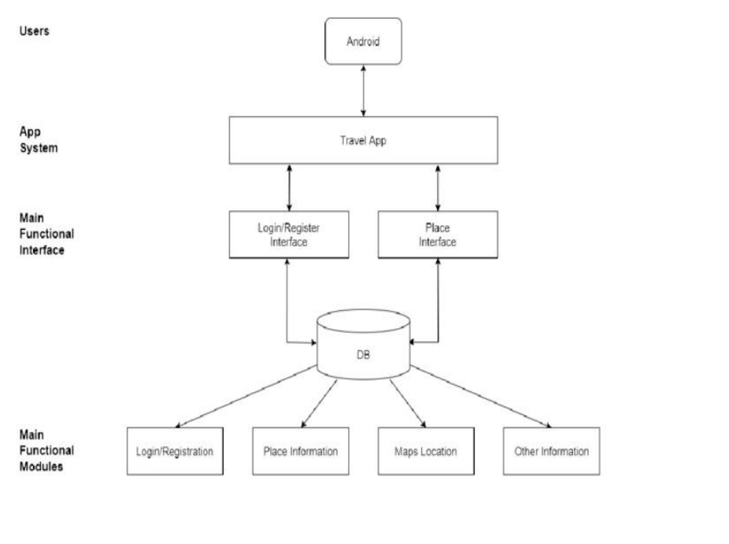
Architecture

Slide 9
software components
Software Requirements:
• Software:
• Development: HTML,CSS,JAVASCRIPT, and Python for Backend
• APIs: Hotel, Cab, Event

Slide 10
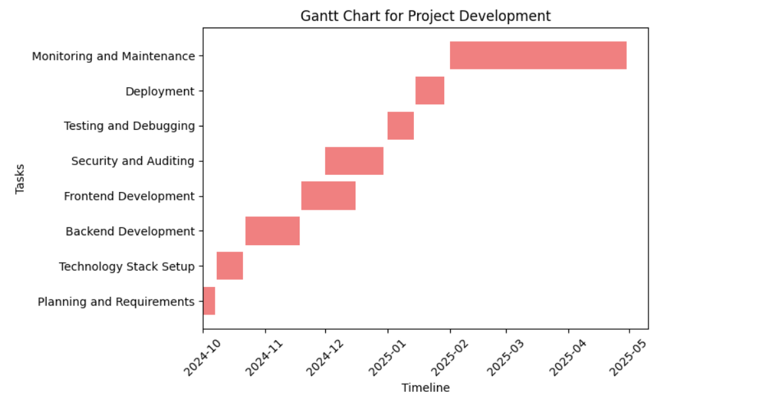
Timeline of Project

Slide 11
Expected Outcomes
Unified Platform Development
Booking Process Optimization
Feedback Mechanism

Slide 12
Conclusion
An integrated booking app that combines cab, hotel, and event bookings into one platform, offering a transformative travel experience through user-friendly design and simplicity. It provides personalized recommendations based on user preferences, ensuring a smooth and enjoyable journey. With a focus on enhancing user satisfaction, the app aims to increase happiness through effective customer support and seamless functionality.

Slide 13
Github Link
.
Github Link
https://github.com/ontri/-A-One-Stop-Solution-focusing-on-Tourism.git

Slide 14
References
Y. Bengio, R. Ducharme, P. Vincent, and C. Janvin, “A neural probabilistic language model,” J. Mach. Learn. Res., vol. 3, pp. 1137– 1155, 2003. [Online]. Available: http://jmlr.org/papers/v3/bengio03a. html
Y. Koren, R. M. Bell, and C. Volinsky, “Matrix factorization techniques for recommender systems,” IEEE Computer, vol. 42, no. 8, pp. 30–37, 2009. [Online]. Available: https://doi.org/10.1109/MC.2009.263
Adeel, M., & Malik, N. M. (2017). Design and implementation of a location-based taxi booking system. Journal of Computer Science, 15(12), 1626-1634
Chen, H., Shu, L., Li, Q., & Jin, H. (2019). An online taxi booking system based on microservices. Future Generation Computer Systems, 100, 72-80

Slide 15
Thank You

